Slide 1

End-to-End Framework for Keyword Spotting
Students:
Ivancich Stefano
Masiero Luca
Supervisors:
Prof. Rossi Michele
Meneghello Francesca
22 September 2020

Slide 2
Outline
The Problem
The Solution
What we tried
Architecture 1: 1DCNN on raw data
Architecture 2: DSConv
Architecture 3: Ensemble
Performance comparisons vs. other papers
Conclusions
Ivancich S. - Masiero L.
22 September 2020
1

Slide 3
The Problem
Keyword Spotting
Detect a relatively small set of predefined keywords (10 or 21) in a stream of user utterances.
Application: Mobile phone, smart home device, consumer and robotics.
Constraints: small footprint and fast (Real Time).
Metrics
Accuracy
Number of parameters
Prediction speed (milliseconds)
Ivancich S. - Masiero L.
22 September 2020
2

Slide 4
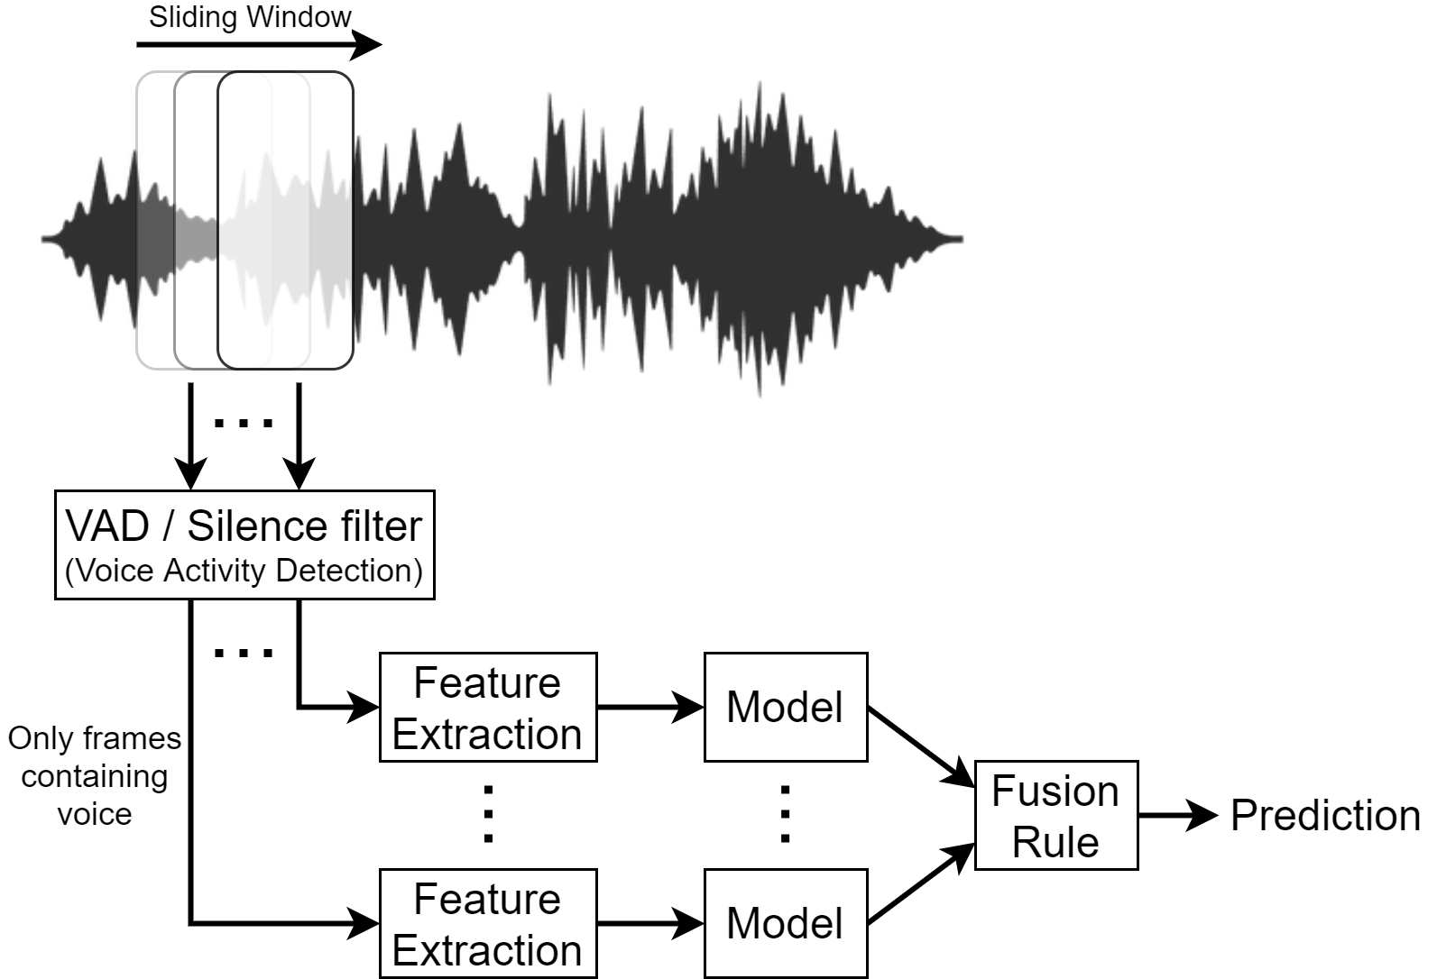
The Solution
Ivancich S. - Masiero L.
22 September 2020
3
Notes:
The input audio waveform X is split into S frames of 1 second.
It is to computational expensive to use the model for each frame. So we can use a VAD (Voice Activity Detection) or Silence filter to let the model process just the frames that contains voice.
This component must be very compact, low computational expensive and very fast, like just ignoring anything under 40db, it can be a piece of software or even a little piece hardware like some home device are using nowdays.
We need to aggregate the CNN predictions to come up to a decision on X.
Fusion rules can be used to reach a ﬁnal decision, such as the majority vote

Slide 5
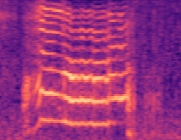
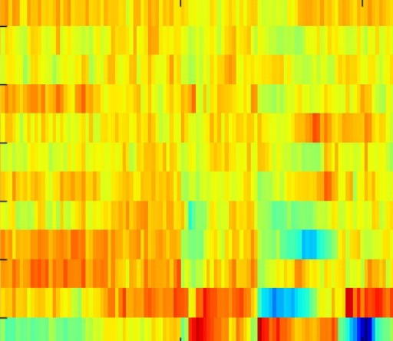
What we tried
Datasets (Google Speech Dataset V2)
10-commands (“yes”, “no”, “up”, “down”, “left”, “right”, “on”, “off”, “stop”, “go”);
21-commands ([…], “zero”, “one”, “two”, “three”, “four”, “five”, “six”, “seven”, “eight”, “nine”, unknown).
Data Preprocessing techniques
No preprocessing (Raw Waveform)
80 Mel spectrogram
40MFCC
40MFCC + 40Δ + 40Δs (=120)
Learning Architectures
1DCNN on raw data
DSConv (Small - Medium - Large)
Ensemble (Small - Medium - Large)
80 Mels
40 MFCC
Ivancich S. - Masiero L.
22 September 2020
4

Slide 6
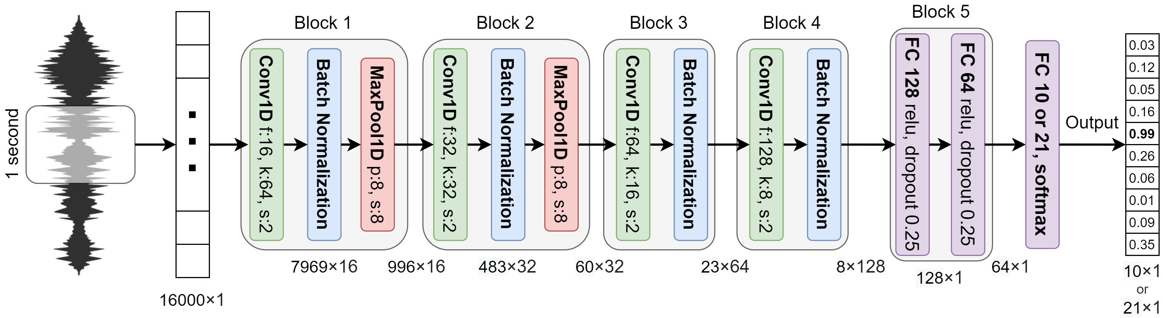
1D CNN on raw data
 | 10-commands (30K – 3K – 3K) | 21-commands (84K – 9K – 11K)
Accuracy % | 93.0 | 89.1
# parameters | 257,018 | 257,733
Speed (ms) | 28.71 | 28.25
Ivancich S. - Masiero L.
22 September 2020
5
Notes:
Input an array of 16,000 dimensions, which represents 1-second of audio sampled at 16kHz.
The architecture is composed of 4 convolutional layers, possibly interlaced with max pooling layers, followed by 2 fully connected layers and an output layer.
In order to reduce the over-fitting, batch normalization is applied after the activation function of each convolution layer.
after the last pooling layer, there are two fully connected layers with 128 and 64 neurons respectively on which a drop-out is applied with a probability of 0.25 for both layers.

Slide 7
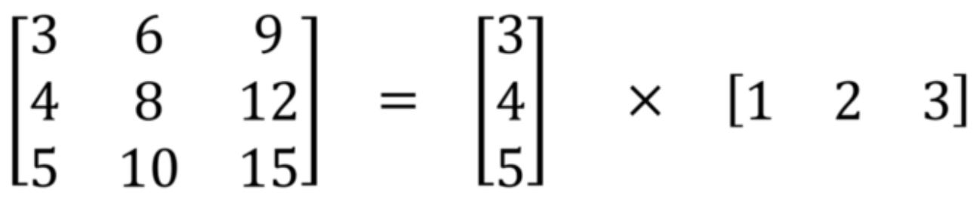
Separable CONV
Separable convolution performs better than regular convolutional layers.
Two types of Separable convolution: Spatial and Depthwise.
Spatial separable convolution divides a kernel into two smaller kernels.
E.g. divides a 3x3 kernel into a 3x1 and 1x3 kernel. Instead of doing one convolution with 9 multiplications, we do two convolutions with 3 multiplications each (6 in total) to achieve the same result.
Problem: not all kernels can be “separated” (mathematically) into two.
Depthwise Separable convolution uses kernels that cannot be “factored” into two smaller kernels.
It splits a kernel into two separate kernels that do two convolutions:
the depthwise convolution;
the pointwise (1x1) convolution.
Ivancich S. - Masiero L.
22 September 2020
6

Slide 8
Depth-wise Sep. CONV
Ivancich S. - Masiero L.
22 September 2020
7

Slide 9
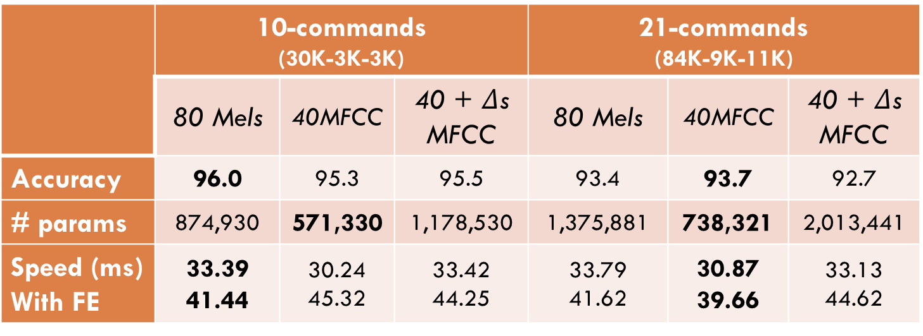
DSConv Model - Large
 | 10-commands (30K-3K-3K) |  |  | 21-commands (84K-9K-11K)
 | 80 Mels | 40MFCC | 40 + $Δ$s MFCC | 80 Mels | 40MFCC | 40 + $Δ$s MFCC
Accuracy | 96.0 | 95.3 | 95.5 | 93.4 | 93.7 | 92.7
# params | 874,930 | 571,330 | 1,178,530 | 1,375,881 | 738,321 | 2,013,441
Speed (ms) With FE | 33.39 41.44 | 30.24 45.32 | 33.42 44.25 | 33.79 41.62 | 30.87 39.66 | 33.13 44.62
Ivancich S. - Masiero L.
22 September 2020
8

Slide 10
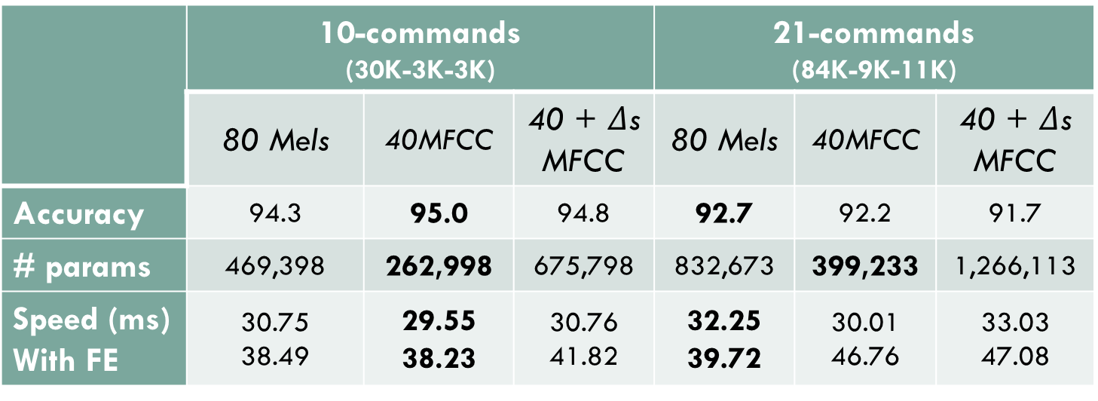
DSConv Model - Medium
 | 10-commands (30K-3K-3K) |  |  | 21-commands (84K-9K-11K)
 | 80 Mels | 40MFCC | 40 + $Δ$s MFCC | 80 Mels | 40MFCC | 40 + $Δ$s MFCC
Accuracy | 94.3 | 95.0 | 94.8 | 92.7 | 92.2 | 91.7
# params | 469,398 | 262,998 | 675,798 | 832,673 | 399,233 | 1,266,113
Speed (ms) With FE | 30.75 38.49 | 29.55 38.23 | 30.76 41.82 | 32.25 39.72 | 30.01 46.76 | 33.03 47.08
Ivancich S. - Masiero L.
22 September 2020
9

Slide 11
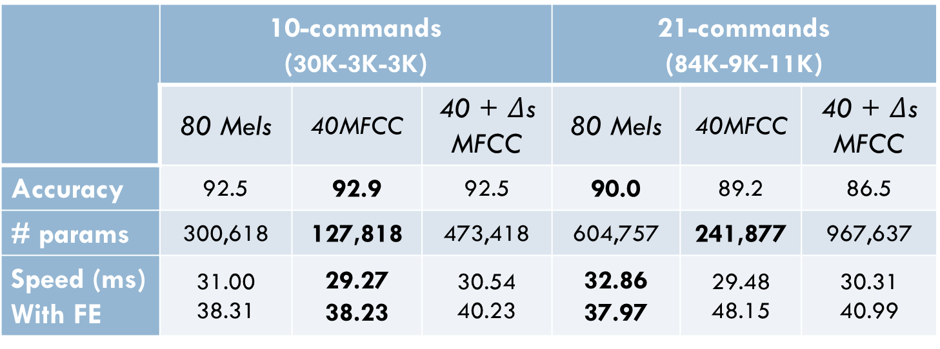
DSConv Model - Small
 | 10-commands (30K-3K-3K) |  |  | 21-commands (84K-9K-11K)
 | 80 Mels | 40MFCC | 40 + $Δ$s MFCC | 80 Mels | 40MFCC | 40 + $Δ$s MFCC
Accuracy | 92.5 | 92.9 | 92.5 | 90.0 | 89.2 | 86.5
# params | 300,618 | 127,818 | 473,418 | 604,757 | 241,877 | 967,637
Speed (ms) With FE | 31.00 38.31 | 29.27 38.23 | 30.54 40.23 | 32.86 37.97 | 29.48 48.15 | 30.31 40.99
Ivancich S. - Masiero L.
22 September 2020
10

Slide 12
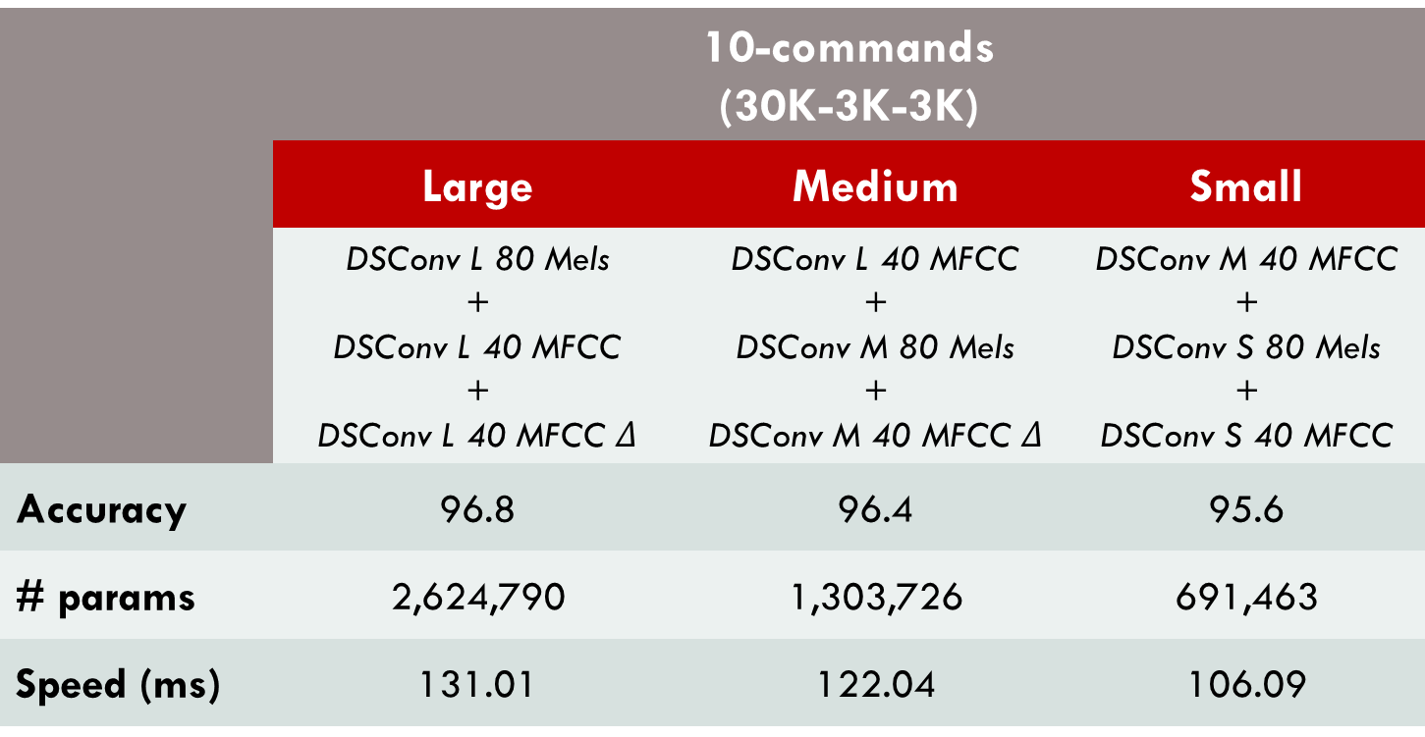
Ensemble: 10-commands
Ensemble between the best models.
 | 10-commands (30K-3K-3K)
 | Large | Medium | Small
 | DSConv L 80 Mels + DSConv L 40 MFCC + DSConv L 40 MFCC $Δ$ | DSConv L 40 MFCC + DSConv M 80 Mels + DSConv M 40 MFCC $Δ$ | DSConv M 40 MFCC + DSConv S 80 Mels + DSConv S 40 MFCC
Accuracy | 96.8 | 96.4 | 95.6
# params | 2,624,790 | 1,303,726 | 691,463
Speed (ms) | 131.01 | 122.04 | 106.09
Ivancich S. - Masiero L.
22 September 2020
11

Slide 13
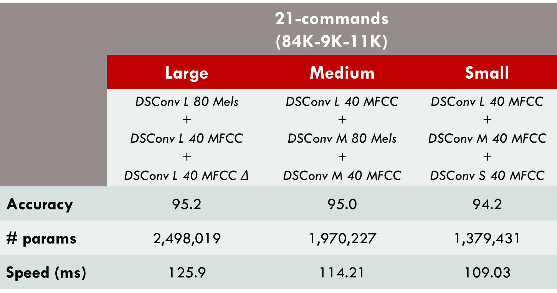
Ensemble: 21-commands
Ensemble between the best models.
 | 21-commands (84K-9K-11K)
 | Large | Medium | Small
 | DSConv L 80 Mels + DSConv L 40 MFCC + DSConv L 40 MFCC $Δ$ | DSConv L 40 MFCC + DSConv M 80 Mels + DSConv M 40 MFCC | DSConv L 40 MFCC + DSConv M 40 MFCC + DSConv S 40 MFCC
Accuracy | 95.2 | 95.0 | 94.2
# params | 2,498,019 | 1,970,227 | 1,379,431
Speed (ms) | 125.9 | 114.21 | 109.03
Ivancich S. - Masiero L.
22 September 2020
12

Slide 14
Performances: 10-commands
 | Accuracy % | # Parameters | Speed (ms)
SincConv [Mittermaier et al.] | 97.4 | 162K | 40.35
Our Ensemble Large | 96.8 | 2,624,790 | 131.01
Our Ensemble Medium | 96.4 | 1,303,726 | 122.04
Our DSConvLarge + 80Mels | 96.0 | 874,930 | 41,44
Our Ensemble Small | 95.6 | 691,463 | 106.09
Our DSConvMedium + 40MFCC | 95.0 | 262,998 | 38,23
Our 1DCNN on raw data | 93,0 | 257,018 | 28,71
Our DSConvSmall + 40MFCC | 92,9 | 127,818 | 38,23
Best: Ensemble Large
Smaller: DSConvSmall + 40MFCC
Fastest: 1DCNN on raw data
Ivancich S. - Masiero L.
22 September 2020
13

Slide 15
Performances: 21-commands
 | Accuracy % | # Parameters | Speed (ms)
SincConv [Mittermaier et al.] | 97.4 | 162K | 40.35
Our Ensemble Large | 95.2 | 2,498,019 | 125.9
Our Ensemble Medium | 95.0 | 1,970,227 | 114.21
Our Ensemble Small | 94.2 | 1,379,431 | 109.03
Our DSConvLarge + 40MFCC | 93.7 | 738,321 | 39.66
Our DSConvMedium + 80Mels | 92,7 | 832,673 | 39,72
Our DSConvSmall + 80Mels | 90,0 | 604,757 | 37,97
Our 1DCNN on raw data | 89,1 | 257,733 | 28,25
Best: Ensemble Large
Smaller: 1DCNN on raw data
Fastest: 1DCNN on raw data
Ivancich S. - Masiero L.
22 September 2020
14

Slide 16
Conclusions
Conclusions
Tests: our model is very good at classifying keywords;
We did not beat the state-of-the-art models;
We found that the number of convolutional layers played a key role in detecting high-level concepts;
No difference between 80 Mels or 40 MFCCs;
Different model sizes in order to fit different devices.
Future Work
Try different hyperparameters during training;
Change the structure of the network using:
SincConv;
GDSConv.
Ivancich S. - Masiero L.
22 September 2020
15

Slide 17
How we have tackled it
1) Literature from:
Teacher’s material
ArchiveX
paperswithcode.com
Reddit
GitHub
Paper’s references
2) For each paper:
What we find useful for our problem?
Which references we want to follow?
1D CNN
Attention
40 MFCC
DSConv
…
Ivancich S. - Masiero L.
20 July 2020
3

Slide 18

How we have tackled it
3) Try to mix from things written down
Example:
Paper X says that MFCC are good for human voice …
Paper Y says that DSConv are faster than normal CNN …
Mixing X and Y will work?
4 ) Debugging:
Bias vs Variance
Error Analysis: look at the misclassified examples
Why didn’t work? When explaining we discovered other things to try
40 MFCC
DSConv
Ivancich S. - Masiero L.
20 July 2020
4

